Slide 1
CSG2005 Computer Vision & Robotics
Dr Mayuri A v r
Senior assistant professor
ViT bhopal

Slide 2
Camera
Many types of imaging devices are available (from animal eyes to video cameras and radio telescopes).
They may, or may not, be equipped with lenses
First model - camera obscura invented in the sixteenth century
Did not have lenses
Use a pinhole to focus light rays onto a wall or a translucent (semi-transparent) plate and demonstrate the laws of perspective.
Of course pinholes have many limitations and they were replaced by more sophisticated lenses.
The modern photographic or digital camera is essentially a camera obscura
Capable of recording the amount of light striking every small area of its backplane

Slide 3
Pinhole Cameras - Perspective Projection
Imagine taking a box
use a pin to prick a small hole in the center of one of its sides and
then replace the opposite side with a translucent plate.
If you hold that box in front of you in a dimly lit room, with the pinhole facing some light source, say a candle, you will see an inverted image of the candle appearing on the translucent plate
This image is formed by light rays issued from the scene facing the box.
If the pinhole were really reduced to a point (which is of course physically impossible), exactly one light ray would pass through each point in the plane of the plate (or image plane), the pinhole, and some scene point.

Slide 4
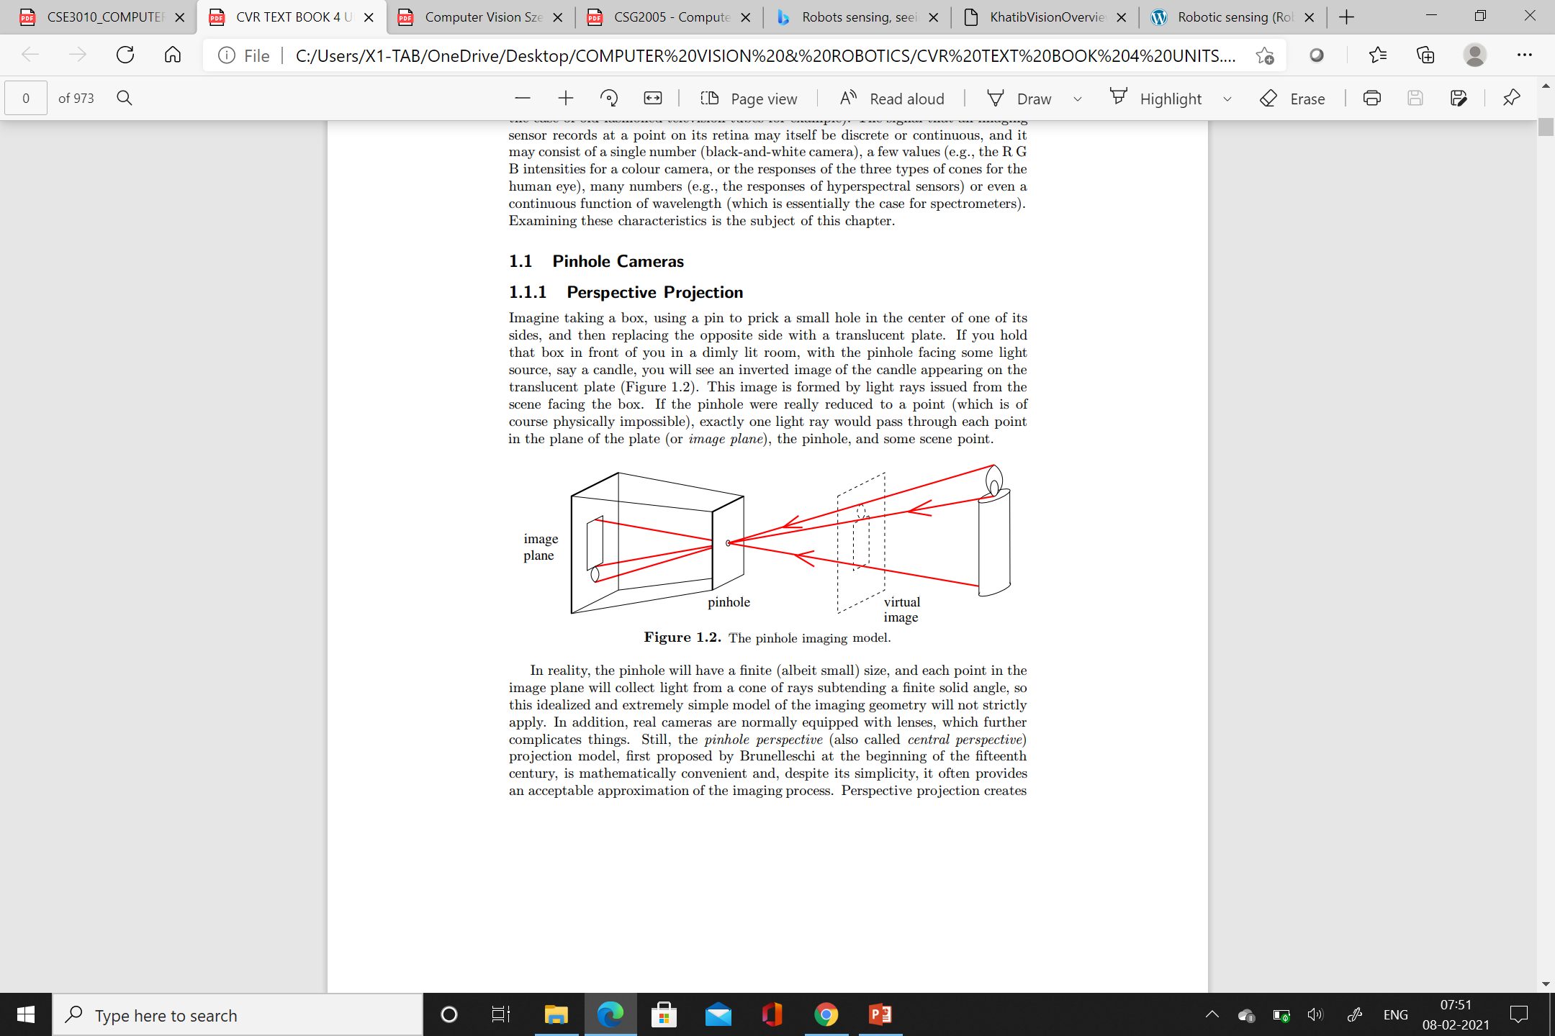

Slide 5
the pinhole will have a finite (albeit small) size, and each point in the image plane will collect light from a cone of rays subtending a finite solid angle.
In addition, real cameras are normally equipped with lenses, which further complicates things.
Still, the pinhole perspective (also called central perspective) projection model, first proposed by Brunelleschi at the beginning of the fifteenth century, is mathematically convenient and, despite its simplicity, it often provides an acceptable approximation of the imaging process.

Slide 6
Perspective projection creates inverted images
It is sometimes convenient to consider a virtual image associated with a plane lying in front of the pinhole, at the same distance from it as the actual image plane .
This virtual image is not inverted
It is strictly equivalent to the actual one.

Slide 7
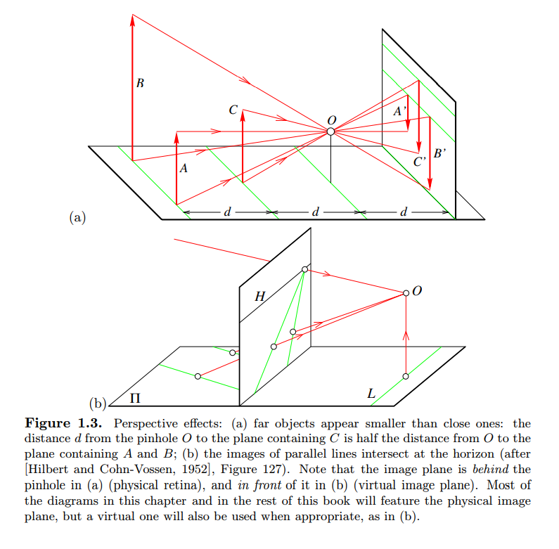

Slide 8
Fig1: the apparent size of objects depends on their distance:
for example, the images B’ and C’ of the posts B and C have the same height, but A and C are really half the size of B.
Fig2: the projections of two parallel lines lying in some plane Π appear to converge on a horizon line H formed by the intersection of the image plane with the plane parallel to Π and passing through the pinhole.

Slide 9
Consider for example a coordinate system (O, i, j, k) attached to a pinhole camera
whose origin O coincides with the pinhole,
vectors i and j form a basis for a vector plane parallel to the image plane Π’
Located at a positive distance f’ from the pinhole along the vector k
The line perpendicular to Π’ and passing through the pinhole is called the optical axis, and
The point C’ where it pierces Π’ is called the image center.
This point can be used as the origin of an image plane coordinate frame,
And it plays an important role in camera calibration procedures.

Slide 10
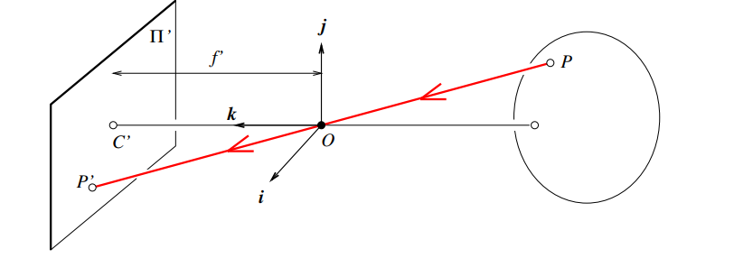

Slide 11
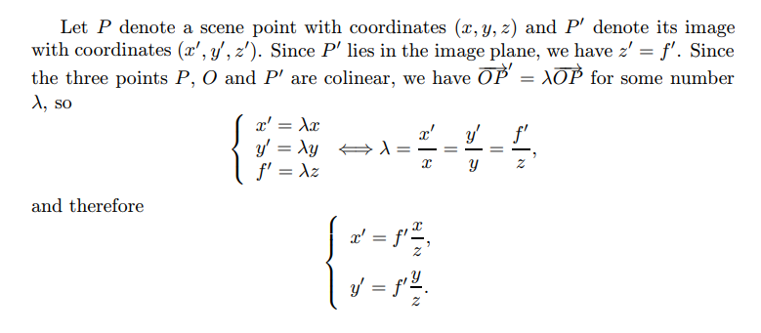

Slide 12
Affine Projection
Two specific affine models, namely weak-perspective and orthographic projections.
A third one, the paraperspective model

Slide 13
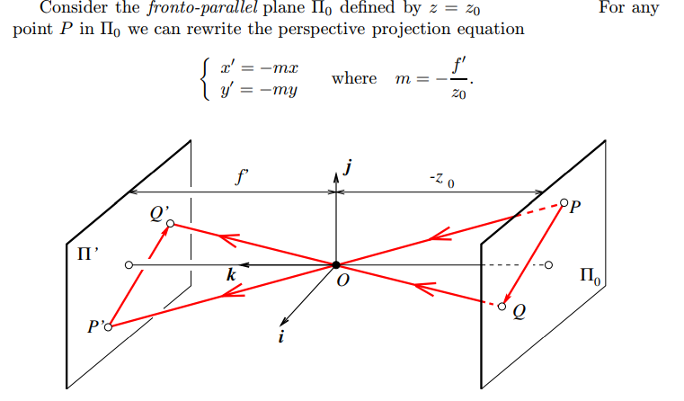

Slide 14
Physical constraints impose that z₀ be negative (the plane must be in front of the pinhole), so the magnification m associated with the plane Π₀ is positive.
Consider two points P and Q in Π₀ and their images P’ and Q’ obviously, the vectors P Q and P’Q’ are parallel, and we have |P’Q’ | = m| PQ|. This is the dependent on the image size.
When the scene depth is small relative to the average distance from the camera, the magnification can be taken to be constant.
This projection model is called weak perspective, or scaled orthography.

Slide 15
When it is a priori known that the camera will always remain at a roughly constant distance from the scene, we can go further and normalize the image coordinates so that m = −1.
This is orthographic projection, defined by x’ = x, y’ = y, with all light rays parallel to the k axis and orthogonal to the image plane Π’
Although weak-perspective projection is an acceptable model for many imaging conditions, assuming pure orthographic projection is usually unrealistic.

Slide 16
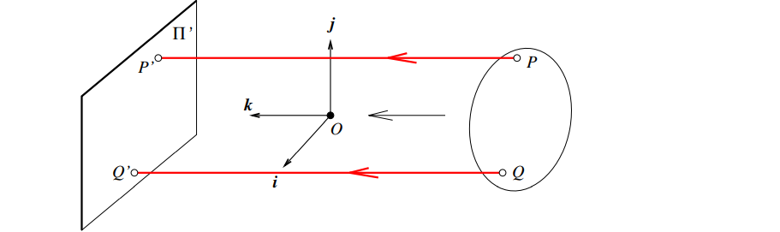
Orthographic projection
Unlike other geometric models of the image formation process, orthographic projection does not involve a reversal of image features. Accordingly, the magnification is taken to be negative, which is a bit unnatural but simplifies the projection equations.

Slide 17
Spherical projection
The imaging surface, or retina, used in both perspective and affine projection models is a plane.
One can of course imagine retinas with other simple shapes, such as cylinders or spheres for example.
Here we consider spherical cameras where light rays passing through a pinhole form images on a spherical surface centered at the pinhole.

Slide 18
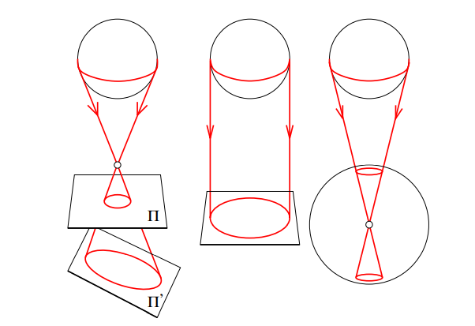

Slide 19
This model is particularly interesting because of its symmetry:
consider for example a sphere observed by conventional perspective and orthographic cameras, as well as a spherical perspective camera (Figure 1.7).
The outline of the sphere in the two perspective images is the intersection of the retina and a double cone tangent to the sphere with its apex located at the pinhole.
Because of the symmetry of the problem, this viewing cone is circular, and it grazes the sphere along a circle.
(left) In the planar perspective case however, the shape of the outline will depend on the orientation of the image plane
if this plane is perpendicular to the line joining the center of the sphere to the pinhole, the outline will be a circle, but in all other cases it will be a non-circular conic section,1 usually an ellipse.
(right) In the spherical projection case, there is no plane orientation to account for, and the outline is always, by symmetry, a circle.
Spheres also have circular outlines under orthographic projection. In this case, the tangent cone degenerates into a cylinder that intersects the image plane along a circle since its axis is always orthogonal to that plane.(middle)

Slide 20
Spherical perspective cameras are “better” than their planar perspective since the pictures they record only depend on the position of the pinhole.
At the same time, they accurately capture the image size, and the image size is dependent on object distance,
So they are also “better” than affine cameras.
One could object cameras that have planar retinas, but it is fact that it is easy to calibrate a planar perspective camera .
A drawback of spherical cameras is that they map straight lines onto circles, which at times complicates calculations.
In reality these are not serious problems, and spherical camera models have their role to play in computer vision.
Indeed, they have proven useful in the study of shape and the analysis of motion (e.g., to recover the shape of smooth objects from sequences of pictures).

